Slide 1
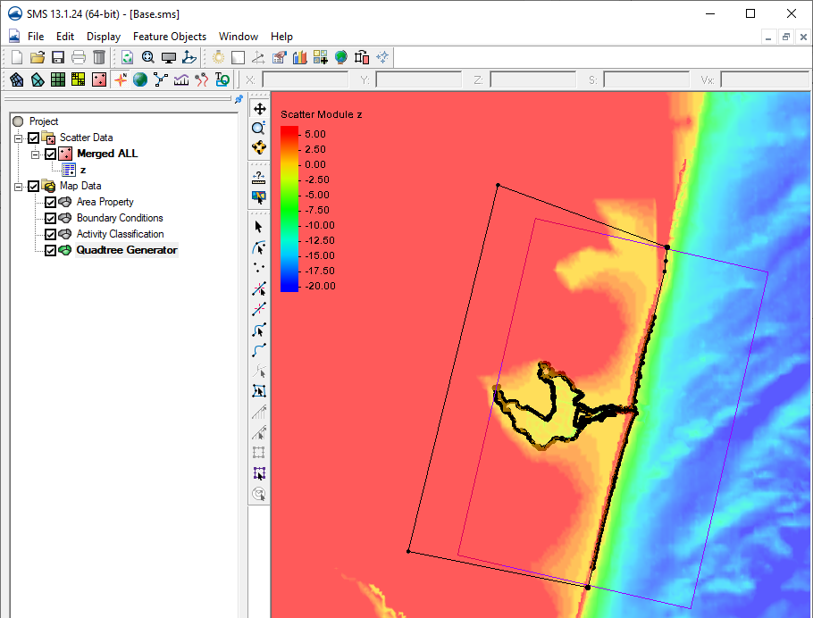
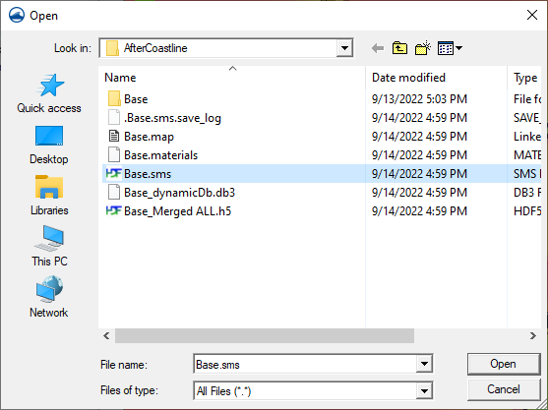
Generating a Telescoping (Quadtree) Grid in SMS 13.1
Open previously saved project to start from.
File | Open → Directory “Workshop\Initial\Aftercoastline”
Note: Your display options may be set differently than shown.

Slide 2
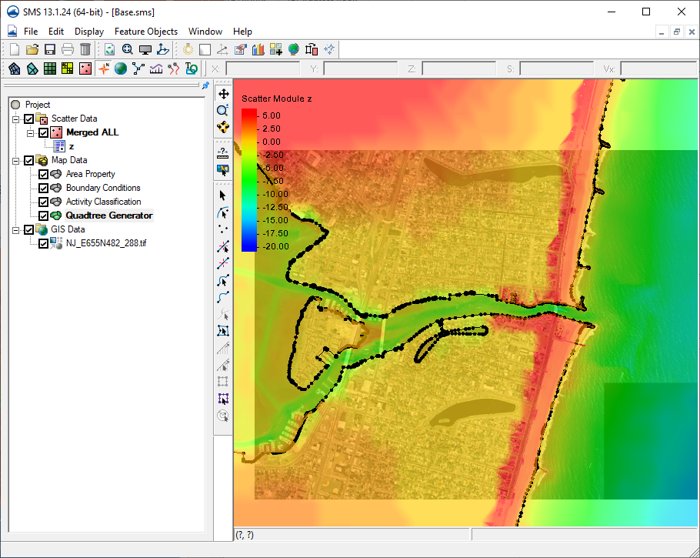
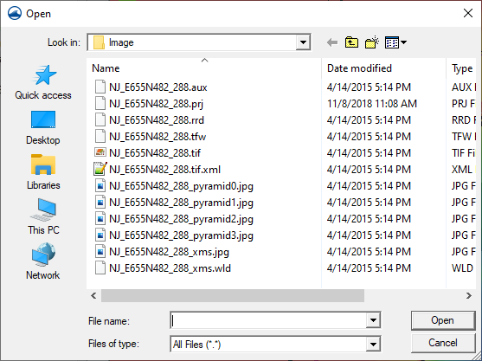
Open a rectified image to display with loaded data
File | Open → Directory “Workshop\Image”
Note: Use a transparency value in Display Options to see through the filled bathymetry contours.
Zoom to full image by right-clicking on the image in the data tree and choose “Zoom to extents”

Slide 3
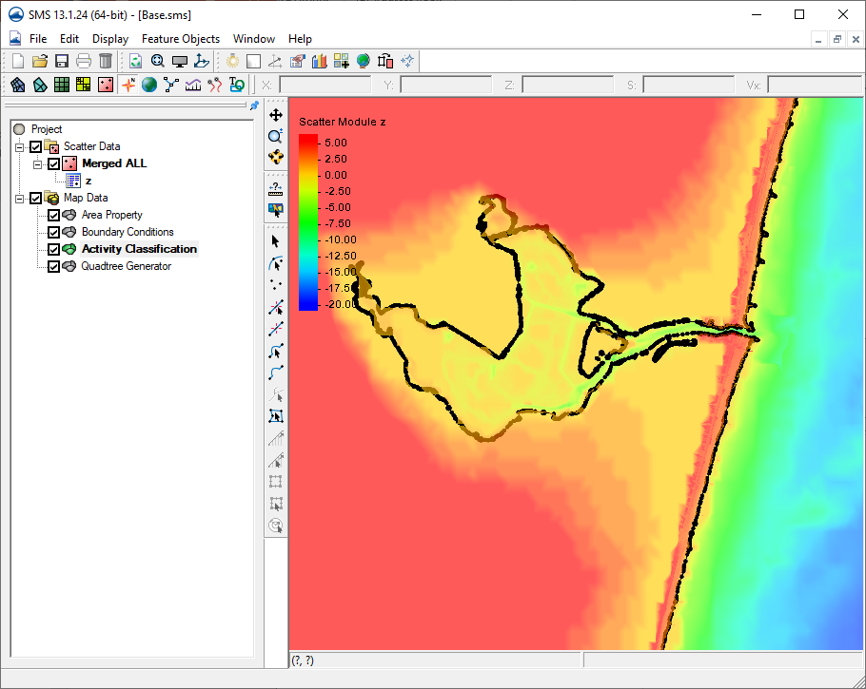
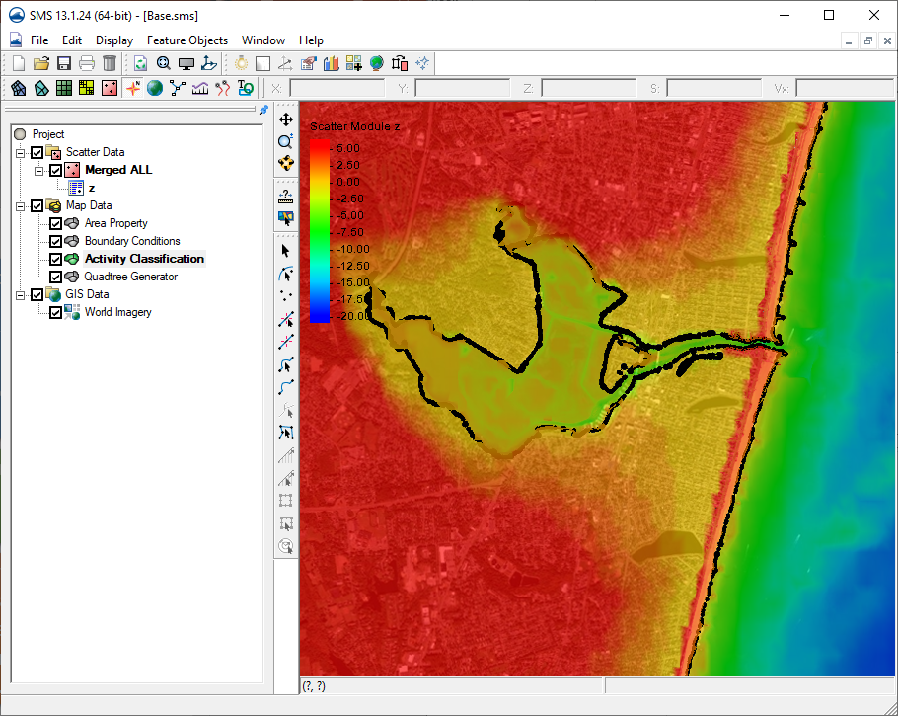
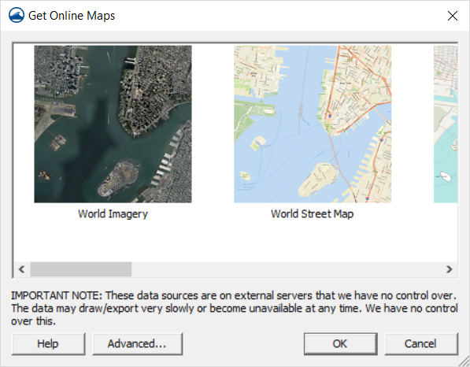
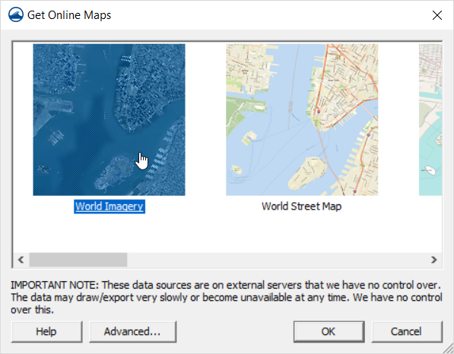
OR use a dynamic image with SMS

Slide 4
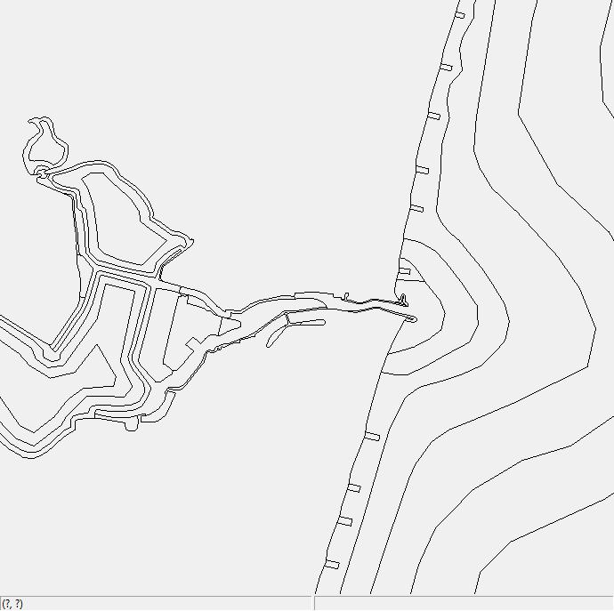
Quadtree Resolution Areas
Resolution for Telescoping grids is done with polygons. Resolution within each polygon will have a set maximum refinement. There can be a transition region as polygons of different cell sizes interact.
An example of the final resolution map for the Shark River Project is shown to the left.
Each polygon can have a different cell size specified. Special attention is given to areas such as inlet throat, jetties, groins, constrictions of flow in the bay, bridges, etc.

Slide 5
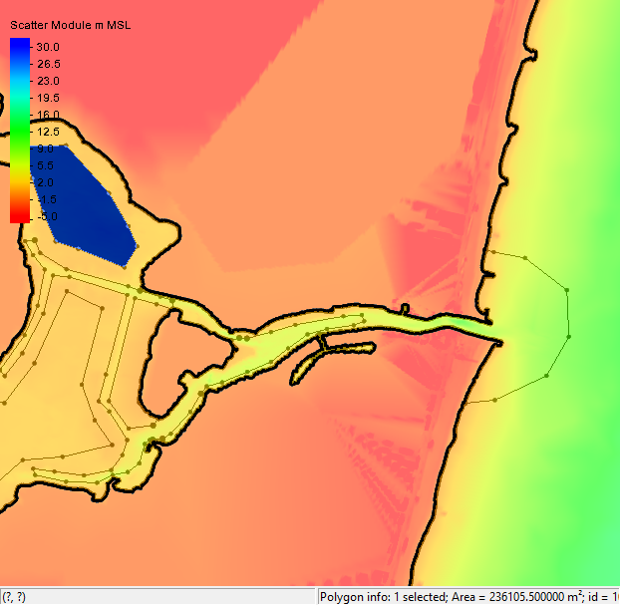
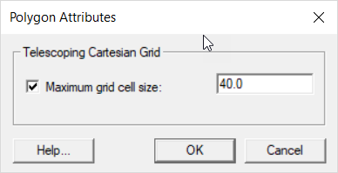
Using the Create Feature Arc tool, create arcs to delineate the areas for resolution. Each zone must form a polygon (no gaps in arcs around the zone).
To set the resolution, click Feature Objects | Build Polygons, select each polygon and right-click and choose attributes.
Check the box named “Maximum grid cell size” and enter a value (units are relative to the horizontal projection).
Example values are shown to the left.
5 m
10 m
20 m

Slide 6
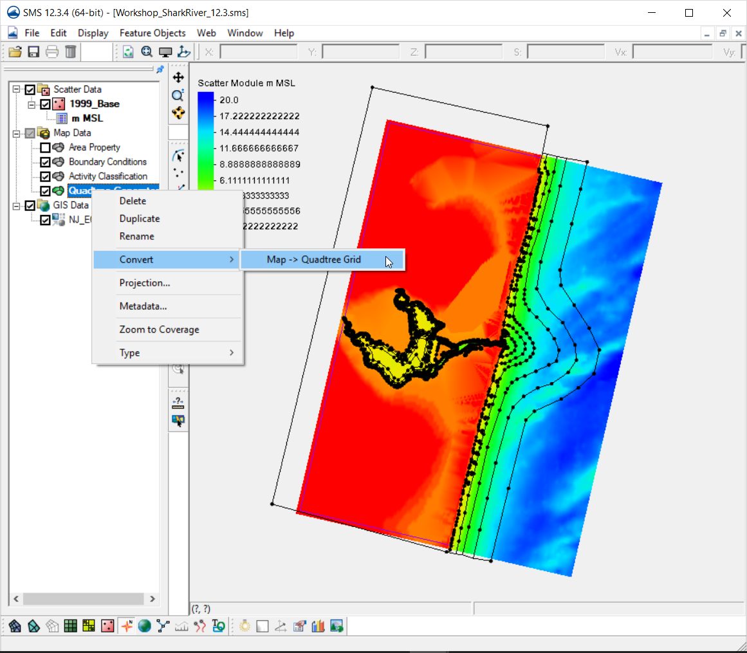
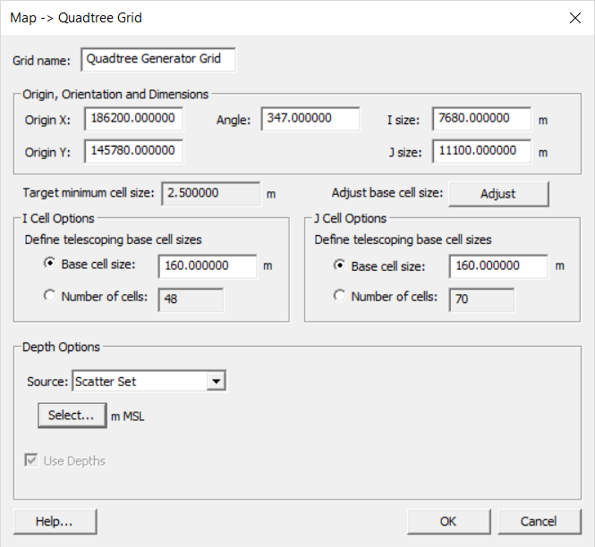
When ready to try to build a grid, SAVE the project first, so you do not lose any work if the program crashes.
Right-click on the Quadtree coverage and choose Convert | Map -> Quadtree Grid
The top part is the same as when the quadtree grid frame was created.
Enter a maximum (base) cell size for areas where no resolution zones are specified.
Set the source for the bathymetry to be your scatter point set.
Click OK and examine the resulting grid.

Slide 7
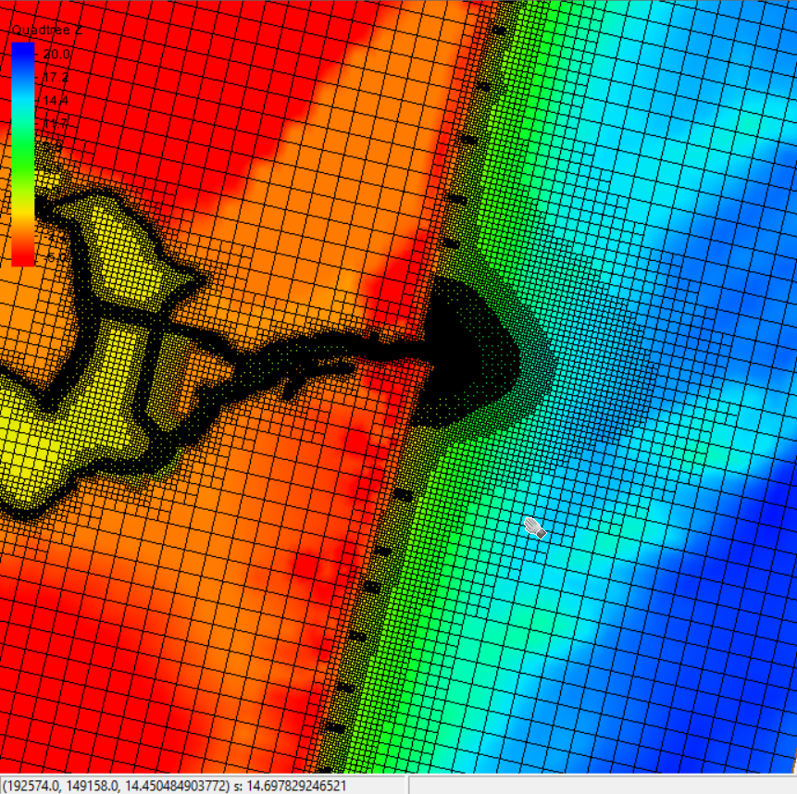
You may need to go into Display Options and show the grid cells to see the resolution.
Tips for Telescoping Grids:
Transition of 2-4 cells per cell resolution change (any direction)
Channels with substantial currents (and transport) should be refined with ~10 cells; main inlet may need closer to 20 cells at flow confluence points.
Structures with variable morphology (e.g. rubble mound) may need extra resolution around edges
Resolution may be necessary in areas of rapid wetting/drying (e.g. wetlands) and sediment transport (e.g. nearshore)

Slide 8
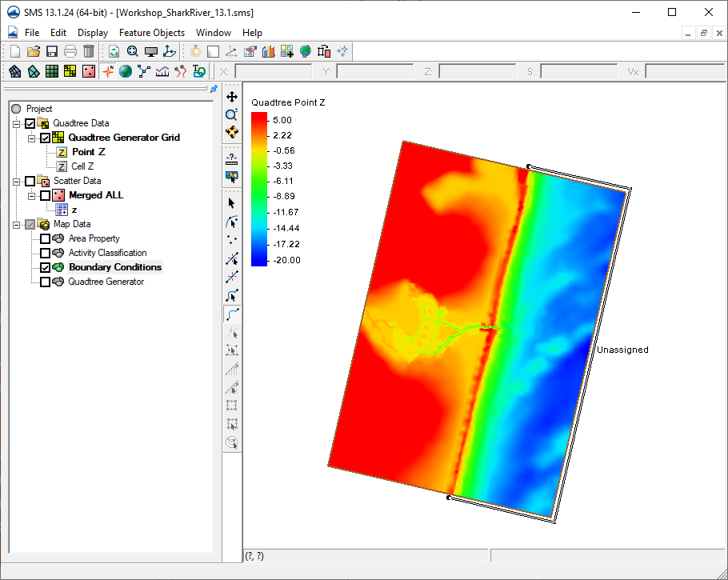
Next, we define the boundary conditions (forcing).
Boundary forcing comes in from the edges by way of Feature Arcs of specific types.
Select the Boundary Condition coverage, then the Create Feature Arc tool.
Click in the approximate location for the type of forcing and create an arc for the boundary condition.
River flux
Water Levels,
Tidal Constituent,
Etc.

Slide 9
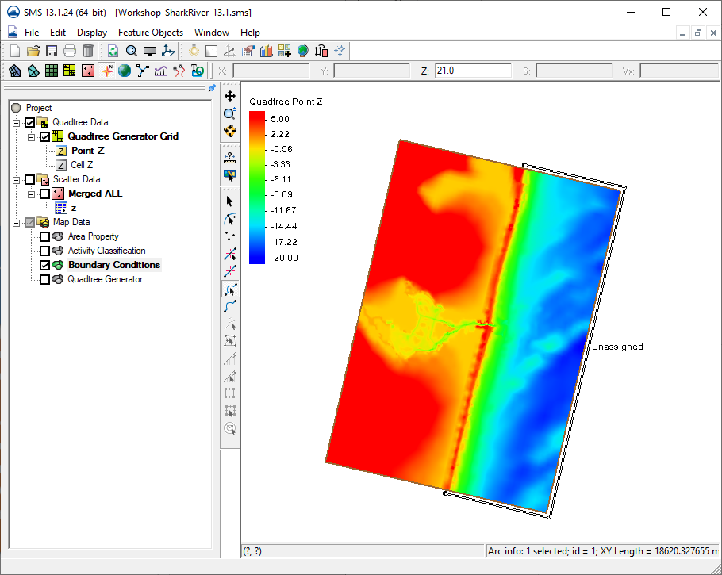
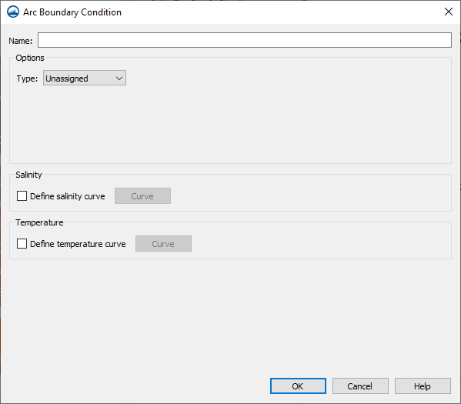
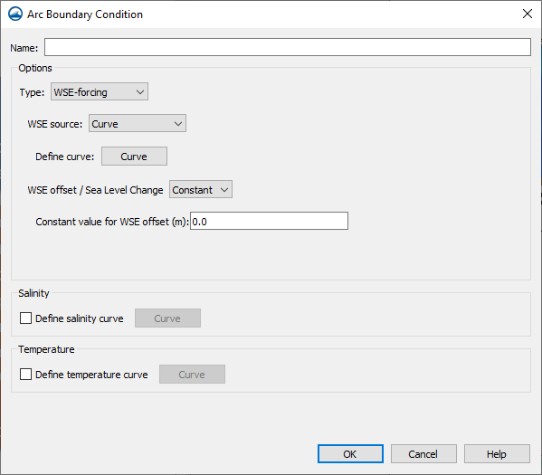
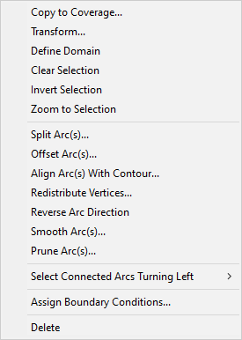
Water Surface Elevation Boundary Condition
Select the Select
Feature Arc tool.
Click, right click
on the arc created.
Choose Assign Boundary Conditions and select the appropriate boundary type. Choose the type “WSE-forcing” and for the source, choose “Curve”.

Slide 10
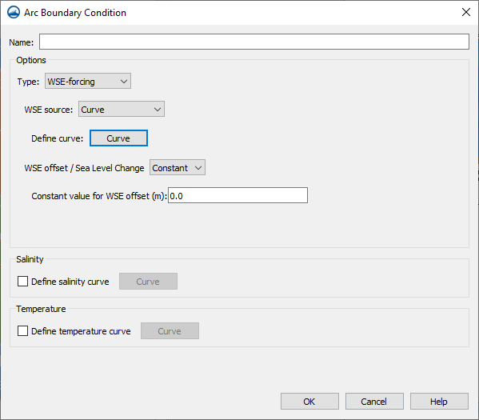
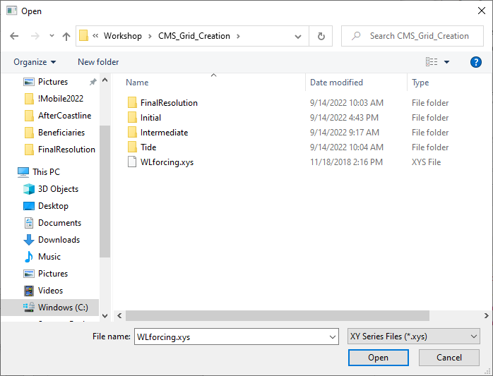
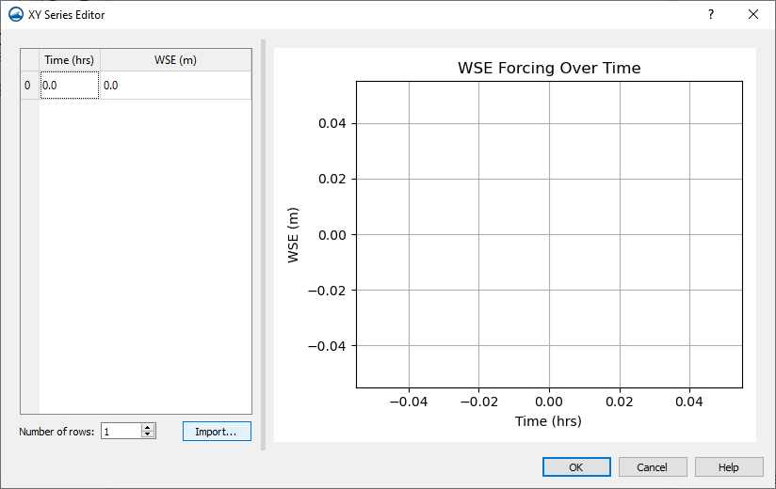
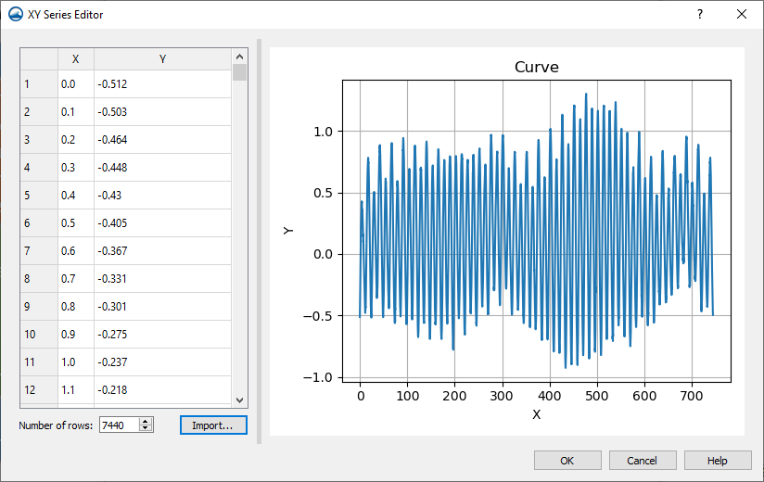
Water Surface Elevation Boundary Condition
Click the “Define curve…” box.
Enter values for time and elevation. This can be by hand, cut/paste from spreadsheet, or importing a file.
Let’s import a file with the data.
Click “Import” and find the file named “WLforcing.xys” which is in the CMS_Grid_Creation directory.
Click “Open”. Click “Ok” to finish.
A Name is optional.
The WSE offset is optional.
Click OK.

Slide 11
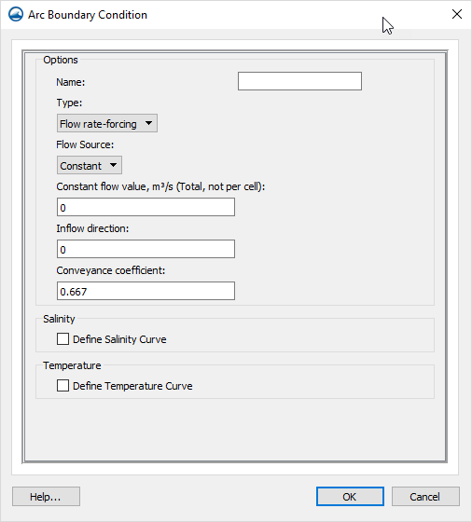
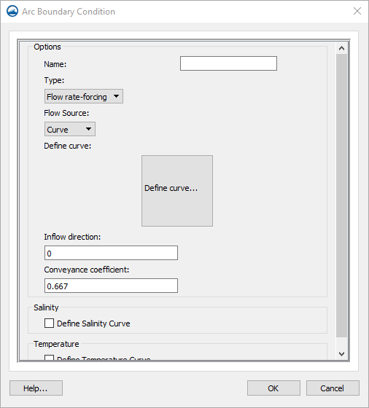
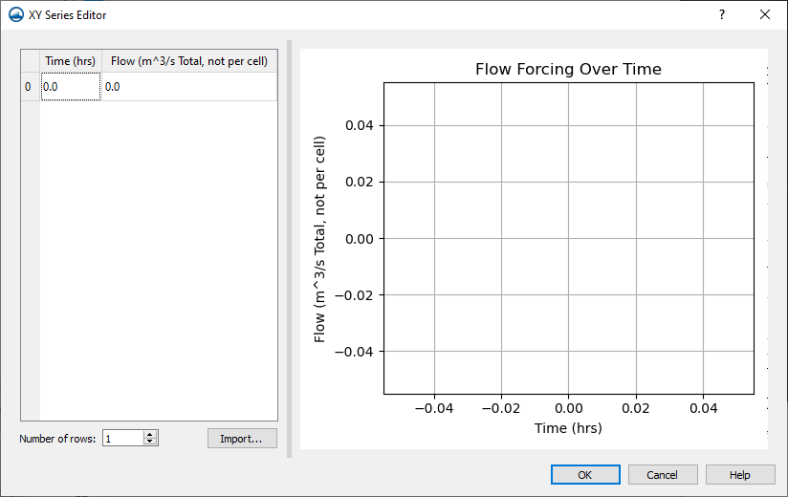
River Flux Boundary Condition (unused now, explanation only)
For River flux, choose the type “Flow rate-forcing”
Choose either a “Constant” or “Curve.”
Note: Flux values differ from previous versions of SMS/CMS. All flux values are Total Flux per arc, and not per cell in the arc.
The curve is set up the same way as WSE elevation boundary condition.
A Name is optional.
Inflow direction should be approximate in degrees clockwise from North. (This will be optional in a future update.)
The Conveyance coefficient can be modified from the default.

Slide 12
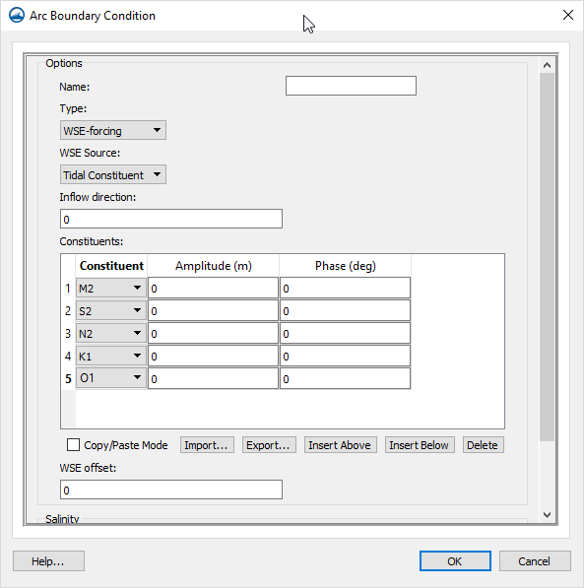
Tidal/Harmonic Boundary Condition (unused now, explanation only)
For Tidal Constituent or Harmonic forcing, select the type “WSE-forcing” and the source as needed. Add rows as needed to represent the constituents desired.
Harmonic has no temporal connection to the start date/time, Tidal does.
A Name is optional.
Inflow direction should be approximate in degrees clockwise from North. (This will be removed in a future update.)
The WSE Offset is optional.

Slide 13
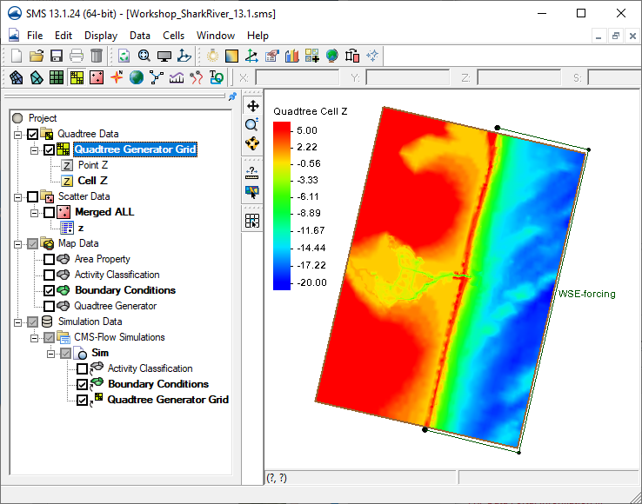
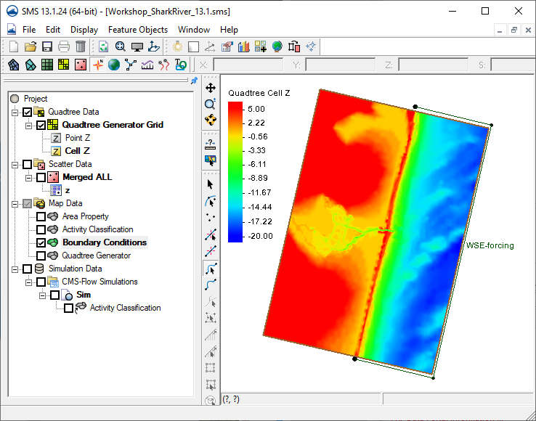
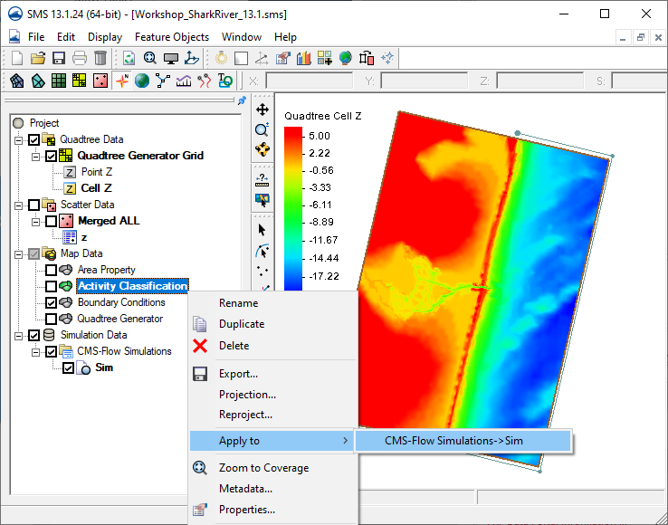
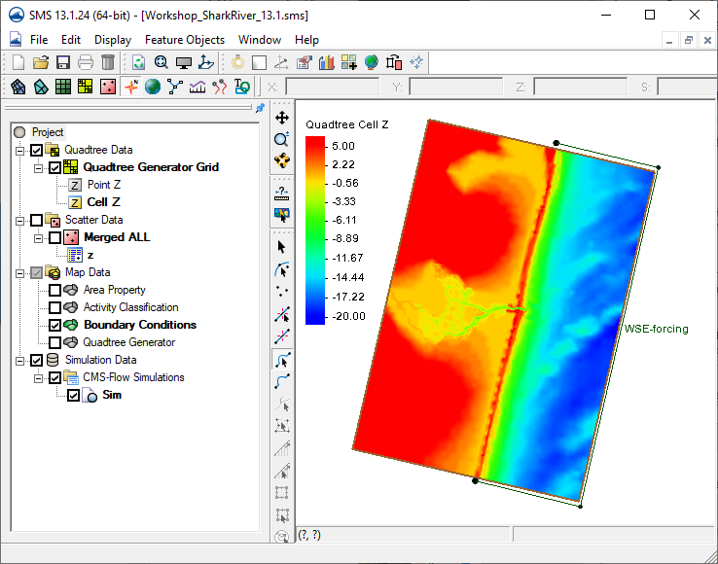
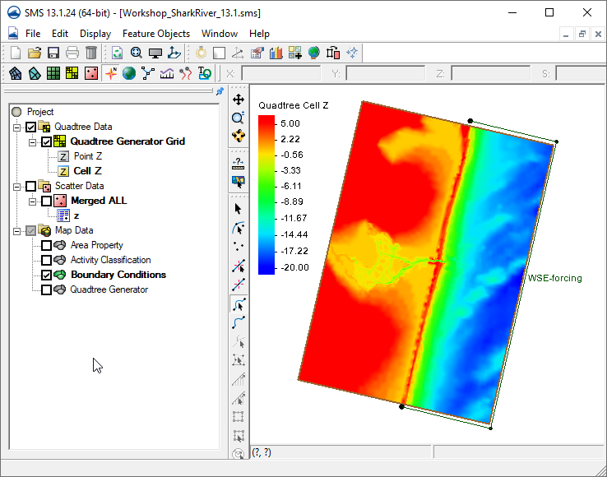
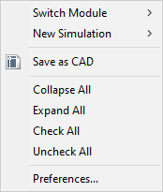

Steps for Running CMS-Flow Create a new simulation
Right click in open space at bottom of data tree to pull up a dialog.
Choose ‘CMS-Flow’
Right click on each object to ‘Apply To’ the simulation
Activity Classification
Boundary Conditions
CMS-Grid (not coverage)

Slide 14
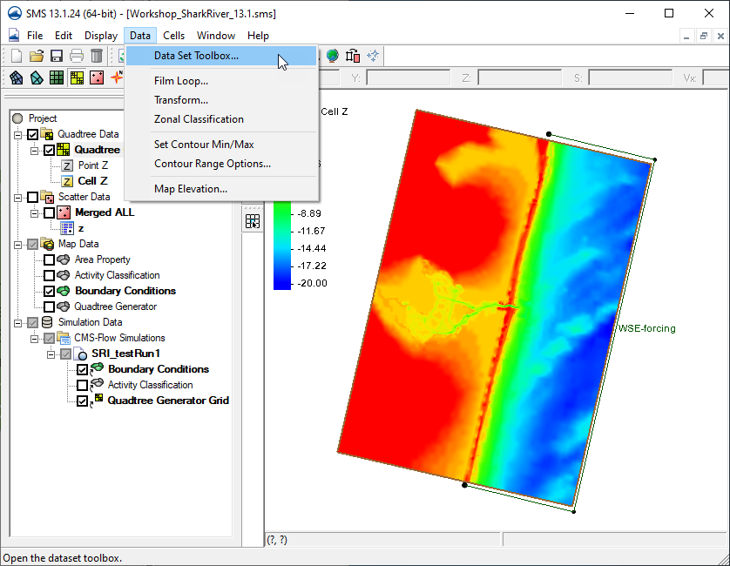
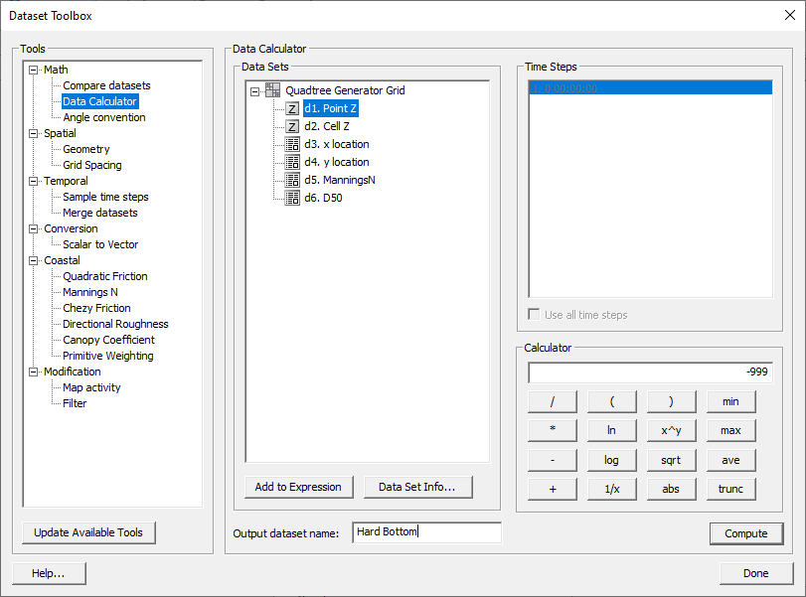
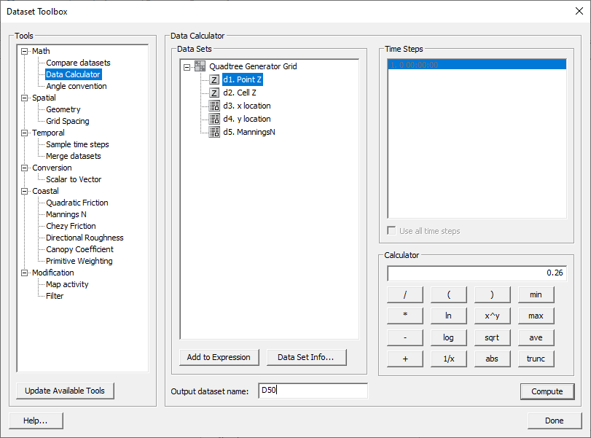
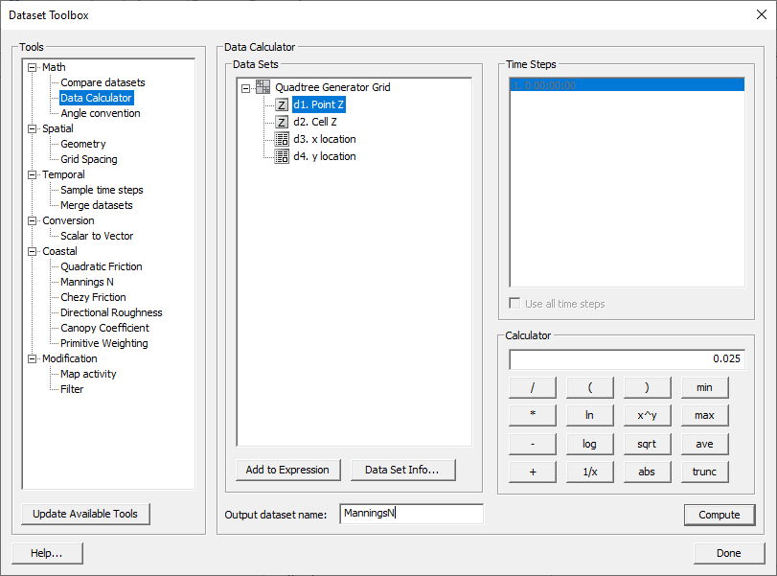
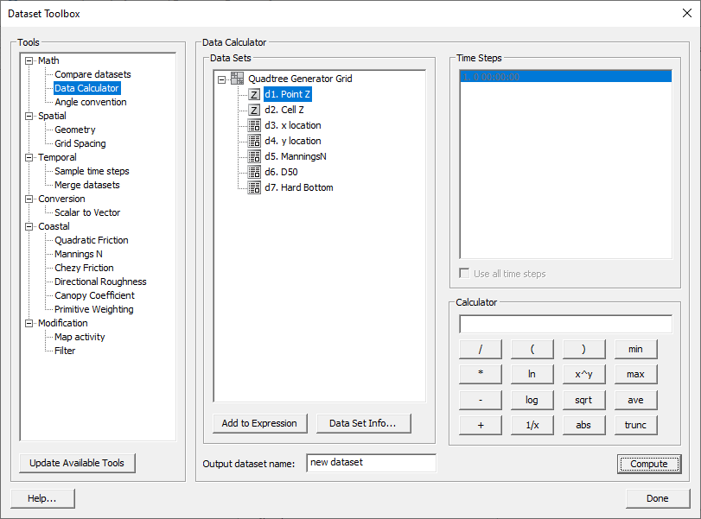

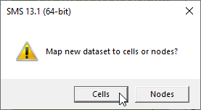
Steps for Running CMS-Flow Creating new Datasets for Model Control
Several datasets should be created to associate with CMS Processes.
These are:
Bottom Friction
Sediment percentile distribution (D50)
Hard Bottom designation
This is done with the Dataset Toolbox | Dataset Calculator

Slide 15
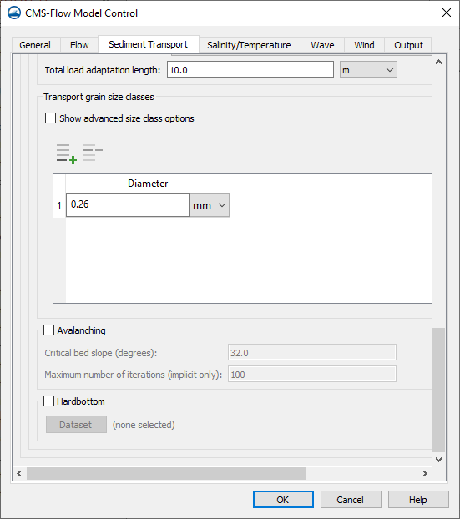
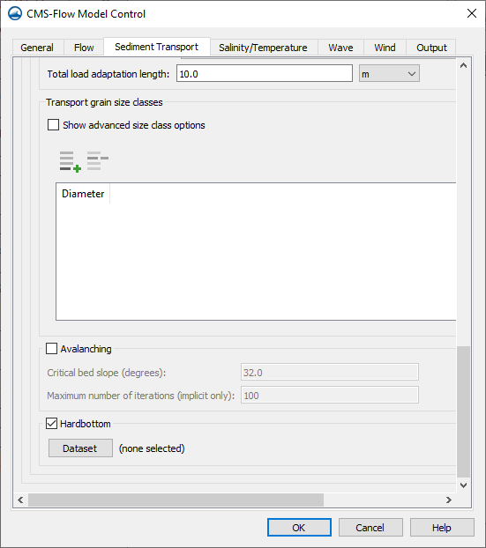
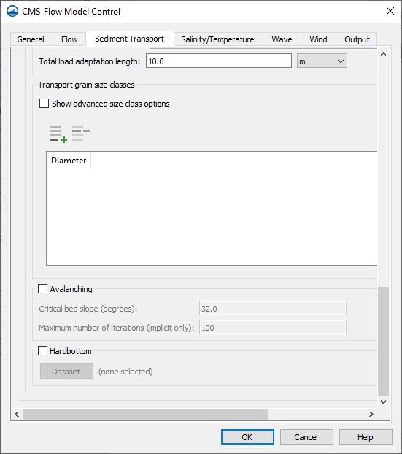
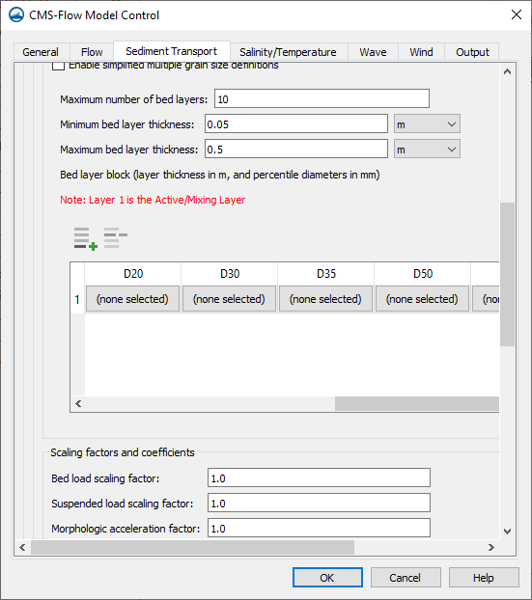
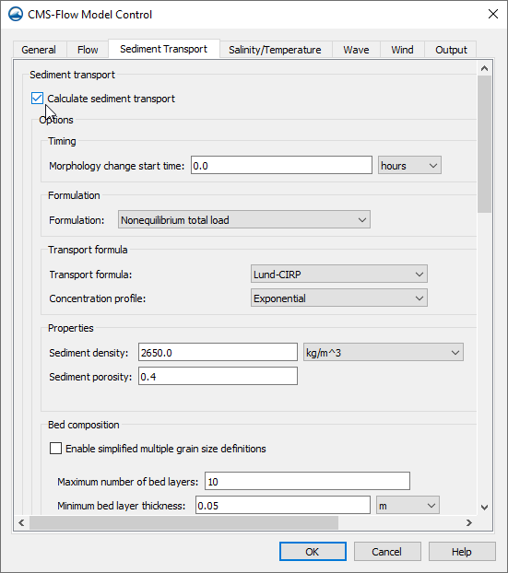
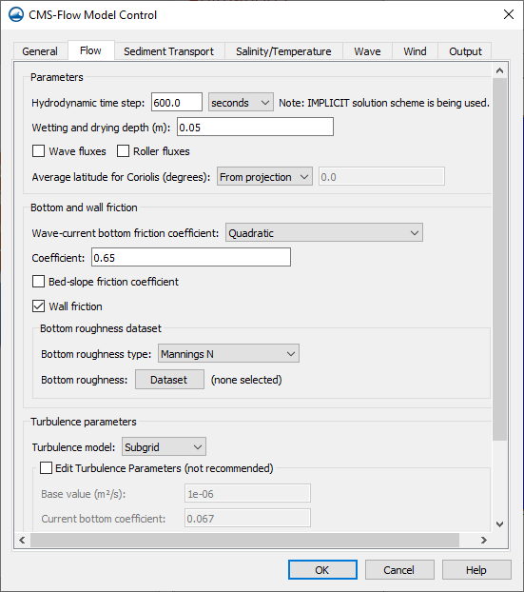
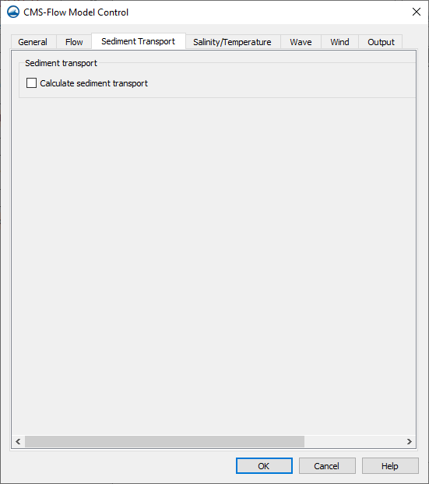
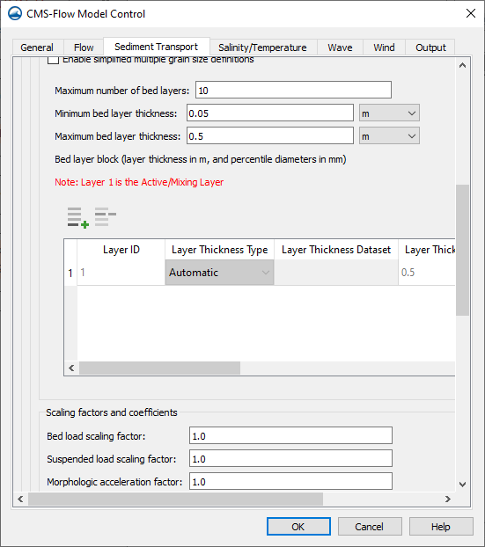
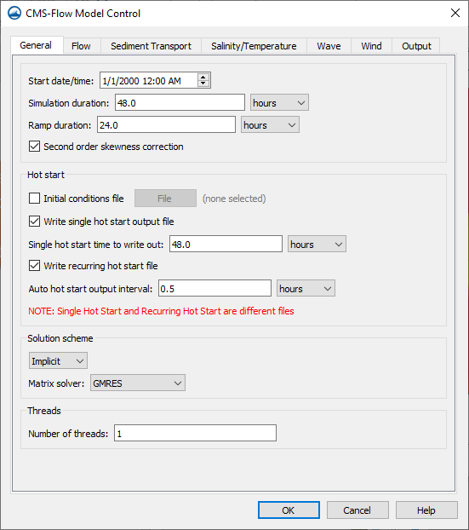
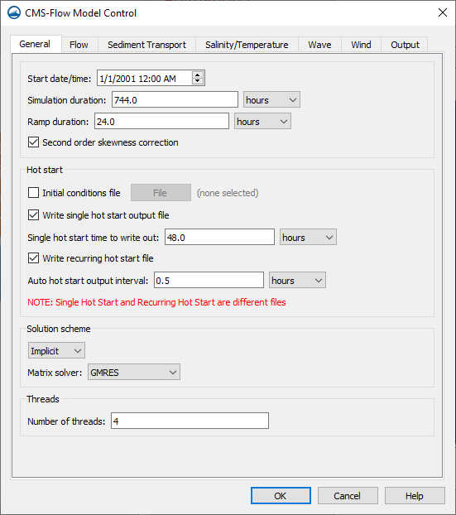
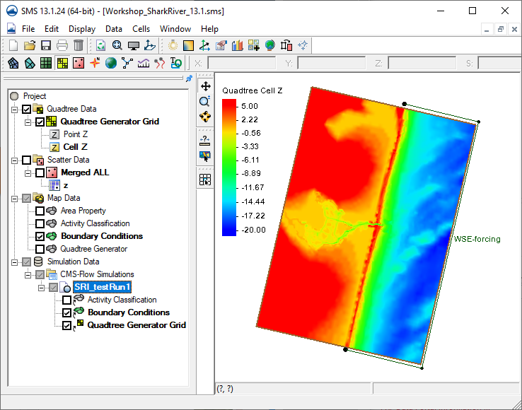








Steps for Running CMS-Flow Defining Model Control parameters
Rename ‘Sim’ something meaningful (Right click, rename)
Right click on simulation and choose Model Control.
Change values as needed on each tab.
Select the ‘ManningsN’ dataset on Flow tab, then click OK.
On Sediment Transport tab, scroll to Bed Composition, and assign ‘D50’ dataset to Bed Layer 1.
Scroll down to bottom of tab to add a Transport grain size
Add Hard Bottom dataset.

Slide 16







Steps for Running CMS-Flow Defining Model Control parameters
Change Simulation label, if desired.
Change increment and end times for List 1, 2, and 3.
Change List to use for Morphology and Transport
Click OK to Exit Model Control

Slide 17





Steps for Running CMS-Flow Save Project, Save Simulation, Run Simulation

